Slide 1
Javascript Everywhere
- by Adam D. Scott

Slide 2
Chapter 1
DEVELOPMENT ENVIRONMENT

Slide 3
Your Text Editor VS Code
Node.js and NPM
Node.js is “a JavaScript runtime, built on Chrome’s V8 JavaScript Engine.” In practical terms this means that Node is a platform that allows developers to write JavaScript outside of a browser environment. Node.js comes with NPM, the default package manager. NPM enables you to install thousands of libraries and JavaScript tools within your projects.
MongoDB
MongoDB is the database that we will be using while developing our API. Mongo is a popular choice for working with Node.js, because it treats our data as JSON (JavaScript Object Notation) documents. This means that it’s comfortable for JavaScript developers to work with from the get-go.
JSON:
JSON is a lightweight format for storing and transporting data which is often used when data is sent from a server to a web page. Also, JSON is "self-describing" and easy to understand.
JSON data is written as name/value pairs, example, "firstName":"Adarsh"
JSON objects are written inside curly braces, example, {"firstName":"Adarsh", "lastName":”Kumar"}

Slide 4
Expo
Expo is a toolchain that simplifies the bootstrapping and development of iOS and Android projects with React Native. We will need to install the Expo command-line tool and, optionally (though recommended), the Expo app for iOS or Android.
Prettier(OPTIONAL)
Prettier is a code formatting tool with support for a number of languages, including JavaScript, HTML, CSS, GraphQL, and Markdown. It makes it easy to follow basic formatting rules, meaning that when you run the Prettier command,

Slide 5
Chapter 2
API INTRODUCTION

Slide 6
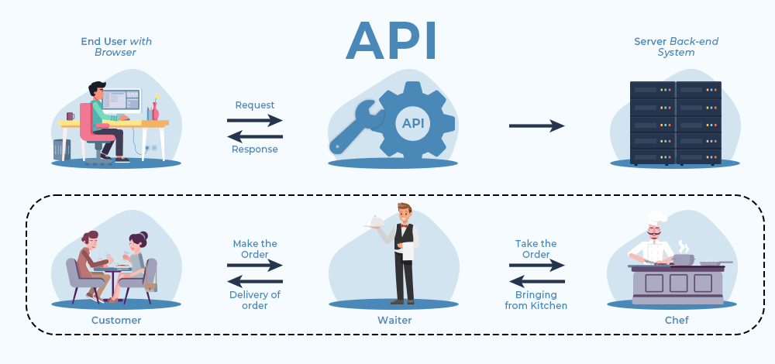

Slide 7
API is an abbreviation for Application Programming Interface which is a collection of communication protocols and subroutines used by various programs to communicate between them.
API helps two programs or applications to communicate with each other by providing them with the necessary tools and functions. It takes the request from the user and sends it to the service provider and then again sends the result generated from the service provider to the desired user.
Steps followed in the working of APIs –
The client initiates the requests via the APIs URI (Uniform Resource Identifier)
The API makes a call to the server after receiving the request
Then the server sends the response back to the API with the information
Finally, the API transfers the data to the client
API’s architectures are:
REST (Representational State Transfer)
SOAP (Simple Object Access Protocol)
Both define a standard communication protocol for the exchange of messages in XML (Extensible Markup Language).

Slide 8
SOAP (Simple Object Access Protocol) is a protocol with specific requirements like XML messaging
Heavier and needs more bandwidth
It defines its own security
It permits XML-based data format only
SOAP calls cannot be cached
SOAP cannot make use of REST whereas REST can make use of SOAP.
A SOAP message is an ordinary XML document containing the following elements:
An Envelope element that identifies the XML document as a SOAP message
A Header element that contains header information
A Body element that contains call and response information
A Fault element containing errors and status information
All the elements above are declared in the default namespace for the SOAP envelope:
http://www.w3.org/2003/05/soap-envelope/
and the default namespace for SOAP encoding and data types is:
http://www.w3.org/2003/05/soap-encoding
REST (Representational State Transfer) follows the constraints of REST architecture allowing interaction with RESTful web services.
It defines a set of functions (GET, PUT, POST, DELETE) that clients use to access server data. The functions used are:
GET (retrieve a record)
PUT (update a record)
POST (create a record)
DELETE (delete the record)
Its main feature is that REST API is statelessness, i.e., the servers do not save clients’ data between requests.
Want to study more about REST APIs: https://www.javatpoint.com/what-is-rest

Slide 9
Chapter 3
A WEB APPLICATION WITH NODE EXPRESS

Slide 10
Express.js is a framework, built on top of Node.js, to build single page, multipage or hybrid web applications. It provides broad range of features such as routing, templating.
To build your first web application, let’s follow the steps below:
Install Node.js on your PC
Create your project folder
mkdir simple-web-app
cd simple-web-app
Initialize your project with Npm & Run the following command to initialize your project:
npm init
Install Express in your project
npm install express — save

Slide 11
5. Create index.js application file
var express = require(‘express’);
var app = express();
app.get(‘/’, function (req, res) {
res.send(‘Simple Web Application is UP’);
}
);
app.listen(8081, function () {
console.log(‘Simple Web Application running on port 8081!’);
}
);
The first line defines variable containing express module and then assigning function call to another variable app. Listen method starts web server on port 8081 and this application returns “Simple Web Application is UP” for GET requests to root url.
Run your application via following command:
node index.js
After running command, you should see the output seen below when you open your web browser with http://localhost:8081/

Slide 12
Chapter 4
Our first graphQL API

Slide 13
What is graphQL?
Advantages of GraphQL
GraphQL or “Graph Query Language” is a query language for APIs.
As SQL is a query language for managing relational databases, GraphQL is a query language that allows the client (frontend) to request data from an API.
One endpoint : With traditional REST APIs, you have to create specific endpoints based on the data you want to request, here just One.
Fewer server requests : GraphQL allows you to make multiple queries and mutations with only one server request.
Declarative data fetching : Unlike a REST API, GraphQL only fetches what you actually need.
Type system : GraphQL uses a type system to describe your data, which makes developing much easier.
Self-documenting : GraphQL is self-documenting, meaning that all of your queries and mutations will automatically be documented by GraphQL.

Slide 14
GRAPHQL BASICS
Schemas: A schema is a written representation of our data and interactions. By requiring a schema, GraphQL enforces a strict plan for our API. This is because your API can only return data and perform interactions that are defined within the schema.
Eg: The Pizza schema might look something like this:
type Pizza {
id: ID
size: String
slices: Int
toppings: [String]
}
Resolvers: Resolvers perform exactly the action their name implies; they resolve the data that the API user has requested.
Queries: A query requests specific data from an API, in its desired format.A query never modifies the data, only accesses it.
Mutations: We use a mutation when we want to modify the data in our API. A mutation is also expected to return a result in the form of an object, typically the end result of the performed action.

Slide 15
What is apollo server?
Since GraphQL is just a query language, we need a library that will take care of the boilerplate code for us.
So, we need Apollo Server which is a Node.js library that provides an easy-to-use GraphQL server.
Apollo Server allows for better scalability and features a larger community.
Apollo Server also provides a neat GraphQL interface for performing queries and mutations during development.

Slide 16
Step 1: Installing Dependencies
mkdir graphql-server
cd graphql-server
npm init -y //This should create a package.json file in your current directory.
npm install apollo-server graphql
we are installing two necessary dependencies.
apollo-server: allows us to create a GraphQL server with ease.
graphql: a required dependency for apollo-server.

Slide 17
Step 2: Creating Our Type Definitions
Our typeDefs are passed into a gql tag. This tag sterilizes our type definitions and makes them readable to Apollo Server. This also allows for auto-completion during development.
The Query type lists all the possible queries that can be performed by our server.
hello and randomNumber are two different queries.
We define the type of the returned value after a colon (:). In this case, hello returns a String type, and randomNumber returns an Integer type.
An exclamation mark (!) after the type indicates a return value is required.
Create an index.js file which will act as the entry point into our server when we finish with the API.
Import ApolloServer and gql from the apollo-server NPM module
const { ApolloServer, gql}=require(“apollo-server”);
Since GraphQL is a typed language, we need to define our data with a schema.
const typeDefs = gql`
type Query {
hello: String!
randomNubmer: Int!
}`

Slide 18
Step 3: Creating Resolver Functions
Now we need to tell our server what to do or return when a specific query is called. We can solve this issue by creating resolver functions.
const resolvers = {
Query: {
hello: () => "Hello world!",
randomNumber: () => Math.round(Math.random() * 10),
},
};
The resolvers should match our typeDefs. Just like we had a Query type in our typeDefs, we have a Query object in our resolvers.
The Query object contains the resolvers that correspond to our typeDefs. (Each query has a corresponding resolver function with the same name)
Whatever you return in the resolver, the query returns to the client.

Slide 19
Step 4: Putting It All Together
it’s time to run our server First, we need to create an instance of ApolloServer and pass in our typeDefs and resolvers.
const server = new ApolloServer({
typeDefs,
Resolvers,
});
server.listen({ port: 8080 }).then(({ url }) => console.log(`GraphQL server running at ${url}`);
First, we created an instance of ApolloServer (which was imported in step 2) and passed in our typeDefs and resolvers, which we made in steps 2 and 3.
Then, we start the server on port 8080 (default is 4000).

Slide 20
FINAL RESULT
const { ApolloServer, gql } = require("apollo-server");
const typeDefs = gql`
type Query {
hello: String!
randomNumber: Int!
}
`;
const resolvers = {
Query: {
hello: () => "Hello world!",
randomNumber: () => Math.round(Math.random() * 10),
},
};
const server = new ApolloServer({
typeDefs,
resolvers,
});
server.listen({ port: 8080 }).then(({ url }) => console.log(`GraphQL server running at ${url}`));
On the left, you will see two tabs: the Schema and the Docs.
When your API grows in size, you can refer to the Schema tab to see all the available queries and mutations the server can perform.
Remember when I mentioned GraphQL was self-documenting? You can see the documentation GraphQL generated for your API in the Docs tab.
The GraphQL playground also allows you to add HTTP headers to your query or mutation. This is useful if you only want authorized users using your API.

Slide 21
Querying our API
Now that our server is all set up, we can send requests to it through the GraphQL playground.
To perform a query, paste the following code into the GraphQL playground:
query {
hello
randomNumber
}
Here, we are calling both of our queries that we set up in the previous steps. Once you click the play button, you should see the data sent back corresponds with what our resolvers returned.
The beauty of GraphQL is that you only get back what you specify; if you remove the hello query, it won’t show up in the data anymore

Slide 22
Creating a More Advanced API -
Step 1: Creating Our “Database”
Create an API that will be able to add and query users. This time, instead of only being able to query data, we will be able to add data as well.
Instead of using an actual database like MongoDB or Firebase, we will use hardcoded data and store everything in an array called users. Each user is going to have a firstName, a lastName, and an email field. If we wanted to, we could include some hardcoded data in the array like:
const users = [
{
firstName: "GraphQL",
lastName: "isCool",
email: "GraphQL@isCool.com"
},
];

Slide 23
Step 2: Setting Up the typeDefs
Now, we need a way to query all the users in our “database.” Let’s update our typeDefs to allow for this function:
const typeDefs = gql`
type User {
firstName: String!
lastName: String!
email: String!
}
type Query {
hello: String!
randomNumber: Int!
queryUsers: [User]!
}`
The queryUsers query returns an array of objects (Hence the brackets).
We can create our own GraphQL types using the type keyword followed by the name of the type.
In curly-brackets ({}), we specify the fields that type will return (Our User type will return three fields: firstName, lastName, and email. All three are strings and required).

Slide 24
Step 3: Configuring Our Resolvers
We just need to add one more line of code to finish the query:
const resolvers = {
Query: {
hello: () => "Hello world!",
randomNumber: () => Math.round(Math.random() * 10),
// queryUsers simply returns our users array
queryUsers: () => users,
},
};
This new line of code creates a resolver function that, when invoked, will return the users array.
Step 4: Testing the Query
Our query will look a little bit different this time:
query {
queryUsers {
firstName
lastName
email
}
}
When we call the queryUsers query, we need to specify which fields we want the API to return in curly-brackets ({}). The code above returns all three fields, but if the client only needs the first and last name of each user, you could omit the email field to save bandwidth:

Slide 25
Adding Users to Our Array - Step 1: Adding a Mutation to Our typeDefs
Whenever you perform any other operations other than reading from a database (creating, updating, deleting), you should use GraphQL mutations.All mutations must be in the GraphQL Mutation type:
const typeDefs = gql`
type User {
firstName: String!
lastName: String!
email: String!
}
type Query {
hello: String!
randomNumber: Int!
queryUsers: [User]!
}
type Mutation {
addUser(firstName:String!, lastName:String!, email:String!): User!
}`
We are creating a new mutation named addUser
addUser takes in three arguments: firstName, lastName, and email. All three arguments are of type string and required (specified in the parentheses)
addUser returns a User type: an object containing the new user’s firstName, lastName, and email.

Slide 26
Step 2: Adding the addUser Resolver
Just like queries, mutations must match our typeDefs and go in the Mutation object.
Every resolver (not only mutations) has access to four parameters, which you can learn more about in the documentation. We only need the second argument for this resolver.
The second argument, args, will contain the firstName, lastName, and email of the new user. If you wish, console.log the args argument in the resolver function to see what data it contains.
Since our “database” is just an array of objects, we can simply push the args object to the users array.
Our mutation needs to return the new user that was created. We can do that by returning the args object.
The resolver will need to get the firstName, lastName, and email arguments from the mutation when we run it.
Then, it will need to push that data as a new object to the users array. Lastly, we simply return the data that was passed into the mutation.
Update your resolvers to match the following:
const resolvers = {
Query: {
hello: () => "Hello world!",
randomNumber: () => Math.round(Math.random() * 10),
queryUsers: () => users,
},
Mutation: {
addUser: (parent, args) => {
users.push(args); // Push the new user to the users array
return args;
},
},
};

Slide 27
Step 3: Calling Our Mutation
Calling mutations is very similar to calling queries in GraphQL:
mutation {
addUser(
firstName: "John",
lastName: "Doe",
email: "john.doe@somemail.com"
) {
firstName
lastName
email
}
}
To signify a mutation, we use the mutation keyword instead of query.
We can pass arguments into a GraphQL query by specifying them inside of parentheses, just like a JavaScript function.
Here, we create a new user with the name of John Doe and the email of john.doe@somemail.com. Feel free to change the arguments if you wish.
Like our queryUsers query, we can choose what fields to return. Remember that this mutation returns only the new user that was created.

Slide 28
Chapter 5
Database

Slide 29
MongoDB
What is MongoDB?
document based database
uses NoSQL database
Difference between mongo & mongod:
mongo is command line shell [kind of program]
mongod is 'Mongo Daemon' which is host process for Database [ kind of compiler]
COMPARISON B/W MONGODB & MYSQL
SQL terms MongoDB terms
database -------------> database
tables -------------> collections
rows —----------> documents(BSON)
columns –------------> fields

Slide 30
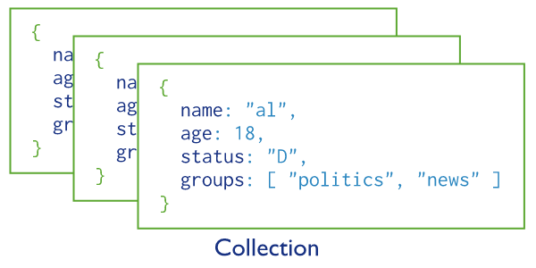
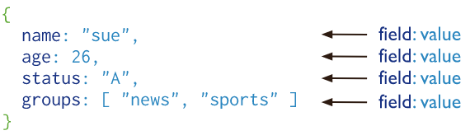
Collection & Document
Document:
Collection:

Slide 31
Installation
INSTALLATION STEPS:
mongodb community server
for windows, download msi file
Select feature as complete
install mongod as a service
then finally install
Go to directory where mongodb is installed, copy path and add it in user variables
However we are going to use Mongodb Atlas which is cloud based service.

Slide 32
MONGODB ATLAS
Visit site https://www.mongodb.com/atlas/database
Create your account or google login.
Create Project.
In Network access, allow from anywhere
In Database access, create user and password.
After cluster formed, click on connect → connect to your application → copy the path of database [here you have to type your password and database name of your choice]
Install Mongodb for VS Code extension in VScode

Slide 33
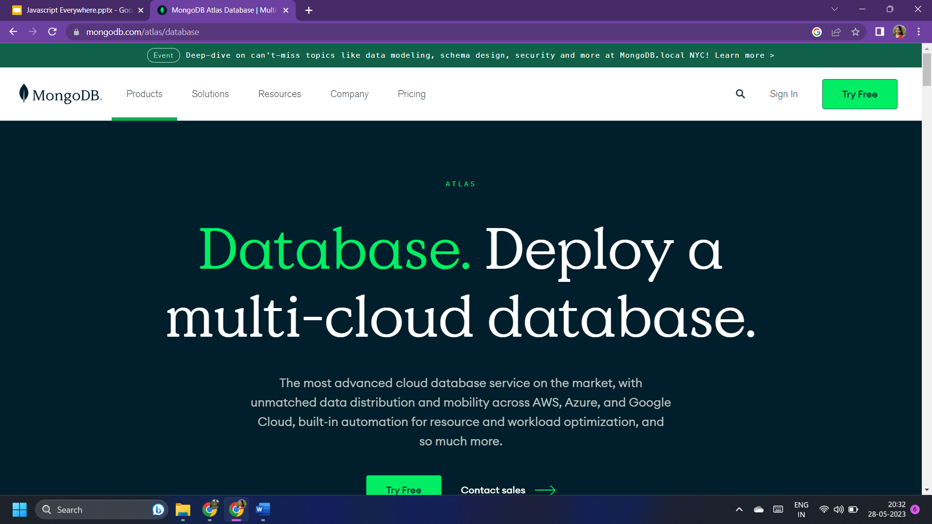
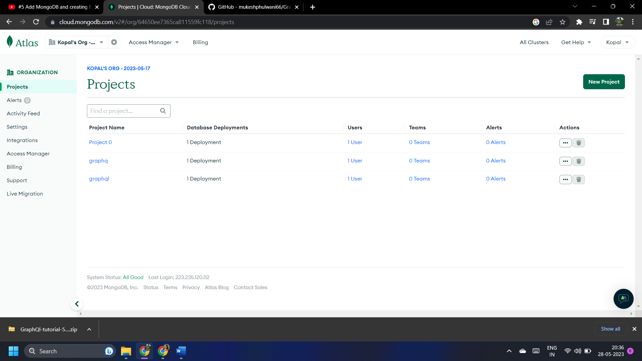

Slide 34
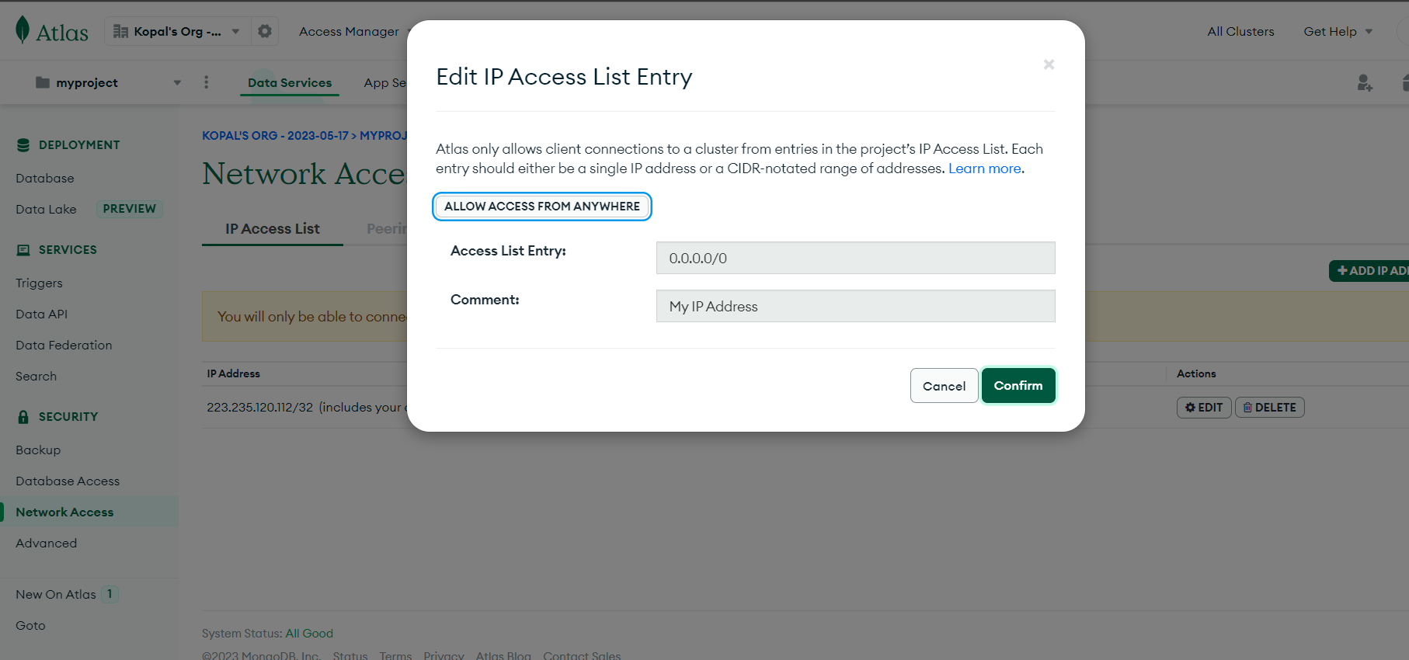

Slide 35
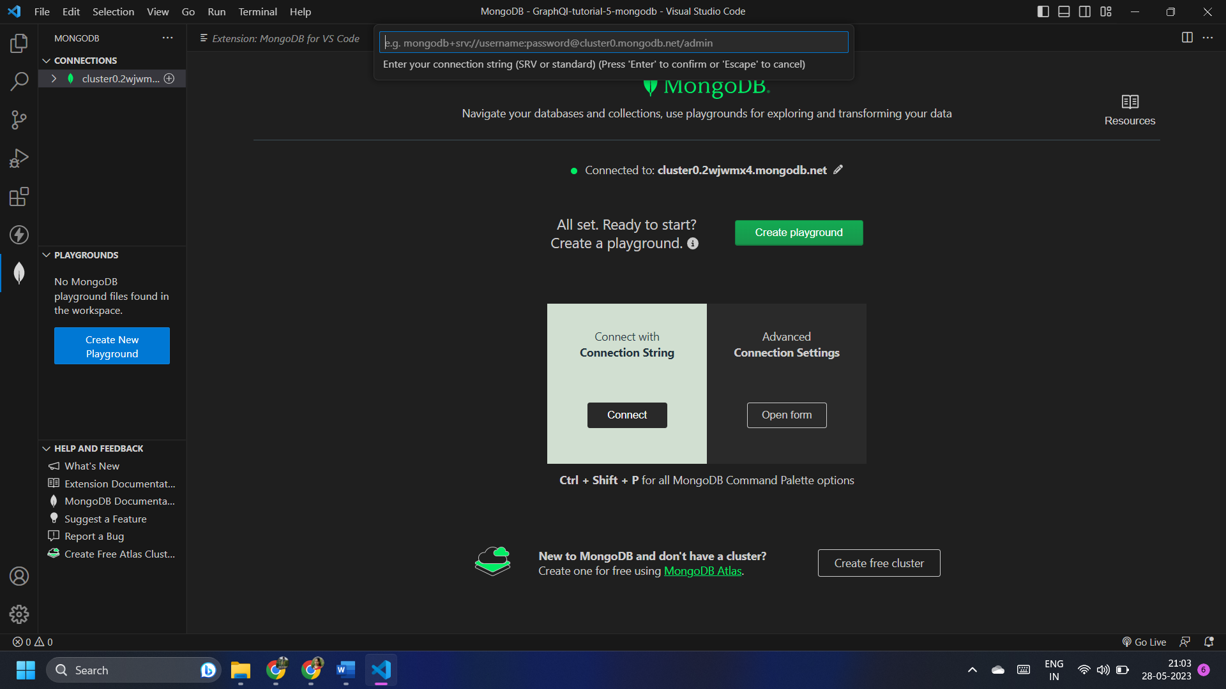
Enter the copied path of database here

Slide 36
Chapter 6
CRUD OPERATIONS of MONGODB

Slide 37
MONGODB COMMANDS FOR DATABASE
//VIEW ALL DATABASE
show dbs
//CREATE NEW DATABASE or
SWITCH DATABASE
use dbName
//VIEW CURRENT DATABASE
db
//DELETE DATABASE
db.dropDatabase()

Slide 38
MONGODB COMMANDS FOR COLLECTION
//SHOW COLLECTIONS
show collections
//CREATE COLLECTION NAME
‘SEMESTER’
db.createCollection(‘semester’)
//DELETE ANY COLLECTION
db.semester.drop()

Slide 39
MONGODB COMMANDS FOR ROWS
//INSERT ONE ROW
db.semester.insert({
'name : 'santosh',
'lang' : 'Java',
'student_since' : 2020
})
//INSERT MANY ROWS
db.semester.insertMany([
{ 'name : 'santosh', 'lang' : 'Java', student_since' : 2020 }
{ 'name : 'qaMIT', 'lang' : 'Java', 'city' :'Bhubaneswar' }
{ 'name : 'AKASH', 'lang' : 'Java', 'DOB' : 01/05/1999
}
])

Slide 40
//show all rows in pretty format
db.semester.find().pretty()
//search in a mongoDB database
db.semester.find({lang : 'Java'})
//limit the number of rows in output
db.semester.find().limit(2)
//count the no of rows
db.semester.find().count()
MONGODB COMMANDS FOR ROWS
// show all rows in collection
db.semester.find()
//show all rows in pretty format
db.semester.find().pretty()
// show all rows in collection
db.semester.find()

